Slide 1
OUR MISSION:
The mission of the Morgan County Partnership Coalition is to collaborate with all community sectors in order to plan and implement local strategies to prevent and reduce youth substance abuse in Morgan County, West Virginia.

Slide 2
OUR VISION:
Our vision is to engage, education and empower our community to ensure that all youth and families have the resources they need to thrive.

Slide 3
2014-2015
Year in Review

Slide 4
Community Candle light Vigil

Slide 5
Community Candle light Vigil

Slide 6
Rx Take Back Day

Slide 7
Above the Influence Campaign
BSHS- Writing Contest Winners
BSHS- Poster Contest Winners

Slide 8
Above the Influence Campaign
WSMS- Writing Contest Winners
BSHS- Poster Contest Winners

Slide 9
What GOOD are you doing? A Positive Youth Media Campaign

Slide 10
What GOOD are you doing? A Positive Youth Media Campaign

Slide 11
What GOOD are you doing? A Positive Youth Media Campaign

Slide 12
What GOOD are you doing? A Positive Youth Media Campaign

Slide 13
What GOOD are you doing? A Positive Youth Media Campaign

Slide 14
What GOOD are you doing? A Positive Youth Media Campaign

Slide 15
New Asset Program- Positive Action
The PAWS-itive Patriot
Angie Hott with WSIS Staff

Slide 16
New Asset Program- Positive Action
Thumbs Up for Positive Action

Slide 17
New Asset Program- Positive Action
Positive Acts Creates Positive Feelings

Slide 18
New Asset Program- Positive Action
Positive Acts Creates Positive Feelings

Slide 19
Berkeley Springs ZOMBIE Walk

Slide 20
Berkeley Springs ZOMBIE Walk
Zombie Float in the Apple Butter Parade

Slide 21
Berkeley Springs ZOMBIE Walk
Our Awesome Volunteers!

Slide 22
Berkeley Springs ZOMBIE Walk
More Zombie Walk Helpers

Slide 23
Berkeley Springs ZOMBIE Walk
More Zombie Walk Helpers

Slide 24
Berkeley Springs ZOMBIE Walk
The Zombie Walk

Slide 25
Berkeley Springs ZOMBIE Walk
The Zombie Walk

Slide 26
Berkeley Springs ZOMBIE Walk
The Zombie After Party @ The Granary

Slide 27
Berkeley Springs ZOMBIE Walk
The Zombie After Party @ The Granary

Slide 28
Berkeley Springs ZOMBIE Walk
The Zombie After Party @ The Granary

Slide 29
Youth Leadership Academy
Cohort 3- Year 1 Students

Slide 30
Youth Leadership Academy
Cohort 3- Year 1 Students

Slide 31
Youth Leadership Academy
Cohort 3- Year 1 Students

Slide 32
Youth Leadership Academy
Cohort 3- Year 1 Students

Slide 33
Youth Leadership Academy
Cohort 2- Year 2 Program Graduates

Slide 34
Youth Leadership Academy
Cohort 2- Year 2 Program Graduates

Slide 35
Youth Leadership Academy
Cohort 2- Year 2 Program Graduates

Slide 36
Youth Leadership Academy
Cohort 2- Year 2 Program Graduates

Slide 37
Youth Leadership Academy
Cohort 2- Year 2 Program Graduates

Slide 38
Youth Leadership Academy
Cohort 2- Year 2 Program Graduates

Slide 39
Morgan County Teen Court
Holds its 100th Hearing

Slide 40
Bully Prevention Training @ Club Day

Slide 41
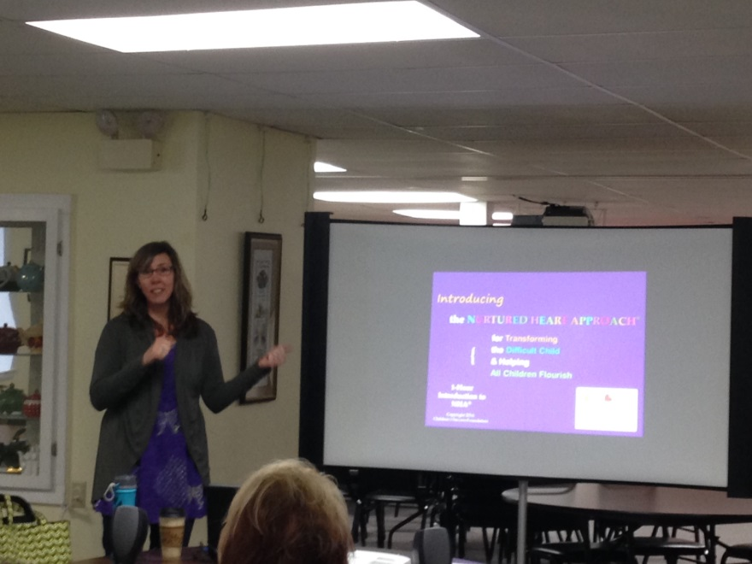
Working with Youth Training

Slide 42
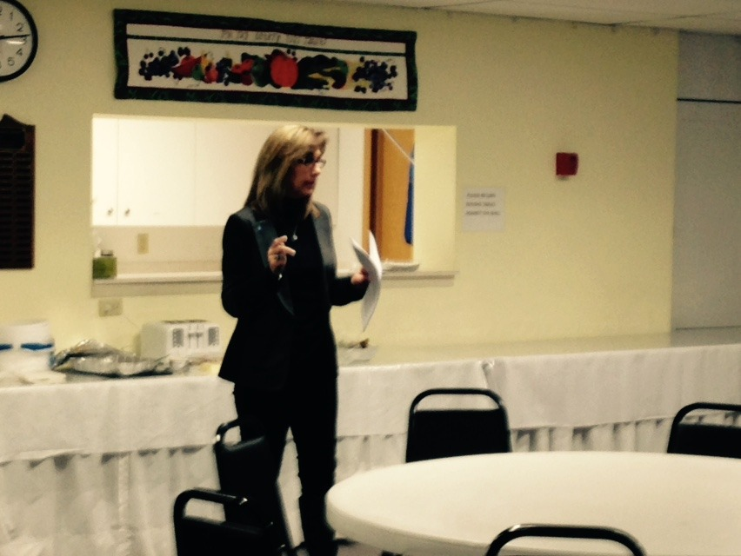
MCP Breakfast Speakers

Slide 43
In the News

Slide 44
In the News

Slide 45
In the News

Slide 46
THANK YOU! For Being a Part of a Another Great Year!

Slide 47
To Reach the Morgan County Partnership

Slide 48
Yoda Quote of the Year

